Slide 1
The CoreSource Value Proposition and Strategic Direction
Steve Horvath VP Product and Marketing Strategies

Slide 2
CoreSource Value Proposition
Notes:
When we say flexib, its not all things to all people.
We see most of what we do being the same capab as BUCA but around a few key areas, we’ll accommodate a client’s needs more than BUCA will.
Most common, this is seen with PBM choices, Network config and data/file feed requests
When we say med mgmt., Orlando is a good example of a value we brought.
Hendrick stayed due to network config and continued work on Aetna/Cigna complement now
Priv label and file feed needs of Commonwealth were what beat Meritain
TMK ee plan is the most complex client we have but a good example of how we flexibly support their needs around (Castlight, Artemis, Be Best Self/YC, network config)

Slide 3
Middle-Market Employer Selection Criteria
Employer Buying Criteria
Network Impact
Programs to Impact Medical Cost Trend
Configuration of Services
Broad Range of Capability & Service Components
Network Offering
Network management for medical and ancillary benefits; Network access fees and admin costs
Medical Management
UM, CM, care management, disease management
Advocacy Services
Healthcare engagement, resources, navigation tools and wellness
Claims Benefit Administration
Claims admin; management of medical, dental, FSA/HRA/HSA plans
Consultative Support
Support clients and brokers to configure products, services, and design benefits
Configuration and Integration
Setup, implementation, enrollment, membership, billing
Customer Service
Customer calls, online requests, inquiries from covered participants
Analytics & Reporting
Analytics, IT support, and client reporting

Slide 4
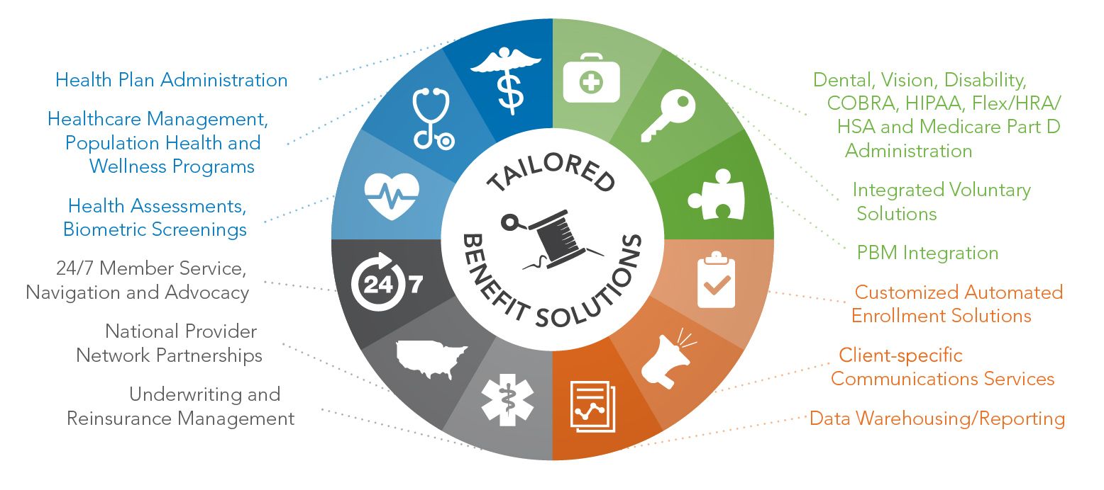
Range of Services = Competitive Differentiator More resources and range of services than local and regional TPAs
Notes:
When we say flexib, its not all things to all people.
We see most of what we do being the same capab as BUCA but around a few key areas, we’ll accommodate a client’s needs more than BUCA will.
Most common, this is seen with PBM choices, Network config and data/file feed requests
When we say med mgmt., Orlando is a good example of a value we brought.
Hendrick stayed due to network config and continued work on Aetna/Cigna complement now
Priv label and file feed needs of Commonwealth were what beat Meritain
TMK ee plan is the most complex client we have but a good example of how we flexibly support their needs around (Castlight, Artemis, Be Best Self/YC, network config)

Slide 5
Flexible Configuration = Competitive Differentiator More personalization and flexibility than national carriers
Components | Examples
Benefit Design | Consultative options for unique needs
Enrollment Choices | Alter ID card or enroll/EOB material
Medical Management | Carve-out specific components
Network configuration | Quilt Multiple and 1st tier networks
Vendor Integration | PBM, Stop Loss, data exchange
Client Decision Driver
Ability to vary key components
Notes:
When we say flexib, its not all things to all people.
We see most of what we do being the same capab as BUCA but around a few key areas, we’ll accommodate a client’s needs more than BUCA will.
Most common, this is seen with PBM choices, Network config and data/file feed requests
When we say med mgmt., Orlando is a good example of a value we brought.
Hendrick stayed due to network config and continued work on Aetna/Cigna complement now
Priv label and file feed needs of Commonwealth were what beat Meritain
TMK ee plan is the most complex client we have but a good example of how we flexibly support their needs around (Castlight, Artemis, Be Best Self/YC, network config)

Slide 6
The CoreSource Formula for a Successful Health Plan
Actionable Data
Risk Mitigation
Tailored Plans
Health
Plan
Benefit Integration
Engaged Employees
Ease Administrative Burden
Please note that this proposal contains confidential information about our clients and our organization. This confidential information should not be disclosed. It should not be duplicated, used or disclosed – in whole or part – for any purpose other than to evaluate our qualifications to provide the requested services.

Slide 7
Actionable Data
In today’s complex healthcare administrative environment, you can’t manage what you can’t see. Access to Actionable Data is imperative to managing current and future Plan objectives.
Data that turns insights into actions for informed decision making
Secure Financial and Plan Management Reporting
Integrated clinical analytics through Verisk Health
Granting clients and brokers access to transparent data, with claim data extracts available
On-line dashboards, self-reporting
Please note that this proposal contains confidential information about our clients and our organization. This confidential information should not be disclosed. It should not be duplicated, used or disclosed – in whole or part – for any purpose other than to evaluate our qualifications to provide the requested services.

Slide 8
Tailored Plans
Through our Actionable Data and comprehensive plan review we can assist in identifying areas of concern and make recommendations Tailored to specific needs.
Consultative Plan and Enrollment Design
Robust Product Portfolio Solutions
Medical Cost Management
Customized Network Configurations
Flexible Vendor Integration
Please note that this proposal contains confidential information about our clients and our organization. This confidential information should not be disclosed. It should not be duplicated, used or disclosed – in whole or part – for any purpose other than to evaluate our qualifications to provide the requested services.

Slide 9
Engaged Employees
Engaged Employees tend to be more productive and fiscally responsible employees. Our programs engage members and help to improve their health, lower their risks and prevent future healthcare spending.
Population Health Management
Wellness Programs
On-line consumerism, cost & quality access, educational and informative tools
Delivering improved employee productivity, attendance and value
Please note that this proposal contains confidential information about our clients and our organization. This confidential information should not be disclosed. It should not be duplicated, used or disclosed – in whole or part – for any purpose other than to evaluate our qualifications to provide the requested services.

Slide 10
Our Value Proposition
CoreSource is your health benefits partner, combining a robust range of services with the flexibility to suit your business. Data analytics and visibility to plan performance drive valuable insights that improve your medical cost trend. And our personal approach to engaging members creates smart, confident healthcare consumers.
Flexible Configuration
Robust
Solutions
People & Relationships
Insights & Guidance
Competitive Differentiators

Slide 11
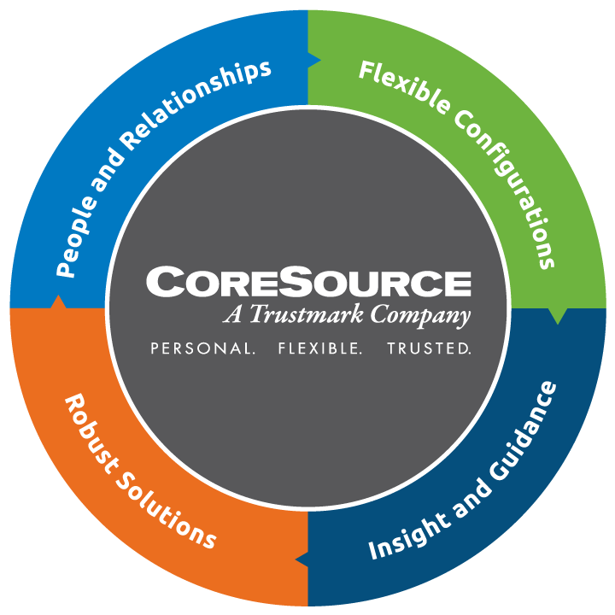
Our Value Proposition
Expect More. Benefit More.

Slide 12
CoreSource Strategic Direction
Notes:
When we say flexib, its not all things to all people.
We see most of what we do being the same capab as BUCA but around a few key areas, we’ll accommodate a client’s needs more than BUCA will.
Most common, this is seen with PBM choices, Network config and data/file feed requests
When we say med mgmt., Orlando is a good example of a value we brought.
Hendrick stayed due to network config and continued work on Aetna/Cigna complement now
Priv label and file feed needs of Commonwealth were what beat Meritain
TMK ee plan is the most complex client we have but a good example of how we flexibly support their needs around (Castlight, Artemis, Be Best Self/YC, network config)

Slide 13
Self-Insured Middle-Market Employers
CoreSource is focused on self-insured middle-market employers
This is a $9.2B market with a steady 5% growth rate
CoreSource competes against ALL the player categories including BUCAs, Carrier TPAs, local/regional TPAs, new point solutions (i.e. enrollment, advocacy, medical management carve-outs)
Notes:
Current focus is mid-market which is experiencing steady growth.
In that market, we today compete against BUCA and non-BUCA

Slide 14
Trends with Implications for the CoreSource Strategy
Segment | Key Trends and Implications
Self-Insured Employer | Shifts in self-insured employer buying options increase pressure to continually innovate solutions and respond to threats (e.g. Exchanges)
 | Industry consolidation presents a short-term opportunity to capitalize on disruption and a long-term need to improve total client cost and network discounts
 | The TPA market remains fragmented with an opportunity to highlight the breadth of services of a health benefits administrator and mitigate the risk of new entrants gaining share with point solutions
Insurer | Unique needs and constraints of small insurers and non-insurer aggregators provides an opportunity to deliver back office support
 | Shifts to value-based care with providers assuming risk highlight growing demand to support administration of both commercial and public business
Provider | Changes in provider approaches and priorities present a new market opportunity to support and facilitate at-risk payment models
 | Clients seeking creative ways to lower costs expect access to the most innovative network options
 | Changing role of providers is impacting their decision-making as employers and increasing importance of clinical data integration

Slide 15
Customer Priorities Have Shifted
Segment | From |  | To
Self-Insured Employer | Transaction, service oriented reporting |  | Analytics driven decisions and processes with shared customer insights
 | Telephonic communications |  | Mobile and omni-channel access
 | Fragmented Customer Experience |  | Integrated and seamless customer service, medical management, coaching, wellness, etc.
Insurer | Commercial-only competencies needed |  | Ability to support payors across multiple lines, including public sector
Provider | Fee-for-Service Providers |  | Providers managing value-based payments and risk arrangements
 | Distribution of solutions from Payers and TPAs |  | New models including private exchanges and combinations of point solutions
 | Analysis of independent data sets |  | Clinical integration with holistic views of information and trends

Slide 16
Provider Shifts are Reshaping the Market Landscape
Provider Risk Continuum
Fee-For-Service
Value Based Payment Models
Provider Health Plan
Bundled Payments
Capitation
Shared Savings
Limited Network and Direct Contracting with Employers
Commercial ACO, Medicare ACO, Pay-for-Performance, Patient Centered Medical Home, Clinically Integrated System, Limited Network and Direct Contracting with Employers etc.
HMO/PPO, Exchange, Med Advantage, etc.
High
Health Plan Influence
Low
Low
Provider Risk
High
Expect more than 50% of health care payments to be value-based by 2020
40% of health systems are projected to extend all the way to Provider Health Plans
Notes:
Most Health Systems will stop short of forming health plans. The number of Provider Plans is growing rapidly (~120 in 2015) but projections indicate most Health Systems (>60%) will stop short of forming plans
There are a wide range of Value-Based models with ACOs, in particular, growing rapidly to ~750 Commercial and Medicare ACOs (or > 20% of Health Systems)
Provider Sponsored Health Plans are launching both Commercial and Public (Medicare/Medicaid) with <15% Commercial-only plans
Direct contracting between self-insured employers and providers is growing
Providers approach to administration of their own self-insured Employee Health plans will be heavily influenced by the shift to value-based strategies.
Direct Contracts Between Providers and Self-Insured Employers
Provide solutions for managing self-insured medical plans that include direct contracting
20% of large Employers are considering establishing direct contracts with providers
Back-office Support of Providers Managing Value-Based Payment Models
Partner with others to support range of functions Providers must execute to manage value-based payments
ACOs are one emerging way to participate in value-based payments with 20% of health systems already in ACOs
Back-office Support of Provider Health Plans
Provide outsourced claims admin, medical management support and leverage existing network and vendor agreements
Health plans will be administering Commercial, Medicaid and Medicare plans, with only 15% of Provider Plans being Commercial only

Slide 17
Two Market Realities Driving the CoreSource Future Strategy
Critical Market Drives |  | Implications
1 | The self-insured employer market is competitive and growing modestly | CoreSource is responding to competition from consolidating BUCA/ASO and Regional TPA solutions To maximize growth opportunity, investing in differentiated innovations to gain share
2 | The role of providers in the healthcare system is changing with the drive toward value-based payment models | CoreSource is supporting the evolving needs of existing Provider-Employers which make up 20+% of clients There is an opportunity to deepen support of Providers in their changing role

Slide 18
Strategy builds upon current core capabilities to better compete for mid-size employers
Current Core Capability
 | VS BUCA |  | VS TPA
 | Flexible Configuration |  | Scope of Services
Future Core Capability
Investment
Medical Benefits Management
Compete better with BUCA
Compete better with
TPAs
Flexible Configuration |  | Scope of Services

Slide 19
Partnering with CoreSource
Flexibility – the ability to create unique, negotiated plans designs, work with multiple vendor partners and managed care/network options
Partnership – the right partner to administer YOUR client plans and what’s in your client’s best interest - allowing your clients to attract, and retain talent, while focusing on other core initiatives
Experience – an administrator with proven success in public sector and consortium benefits administration, customizing plans and risk mitigation
Access – access to clinical data mining, operational and financial reporting and wellness solutions data
Resources – experienced, dedicated staff with local service and decision making, with the backing and resources of a strong parent company
Solutions – the right solutions facing client issues today and into the future
Please note that this proposal contains confidential information about our clients and our organization. This confidential information should not be disclosed. It should not be duplicated, used or disclosed – in whole or part – for any purpose other than to evaluate our qualifications to provide the requested services.

Slide 20
Questions?

